Slide 1

Data Vizualization
Red Wine Quality Prediction

Slide 2
Business Problem & Approach Used
Business Problem:
A Quality Assurance Engineer want to predicting Red wine Quality from a data source which has some variables based on which quality can be easily determined.
The dataset has some input variables based upon physicochemical test, using that is used to predict wine quality.
Quality level 7 or more than that is considered to be good quality ones.
Approach Used:
Searched data from various data source. Verified all input variables suitable for preparing wine. Checked for the dependent variable.

Slide 3
Data Sources & Technology Used
Data Source:
UCI machine learning repository, https://archive.ics.uci.edu/ml/datasets/wine+quality
Technology Used:
Tableau, Jupyter Notebook, PowerPoint presentation.

Slide 4
Vizualizations: 1. Diaplaying all attributes of dataset.
fixed acidity | volatile acidity | citric acid | residual sugar | chlorides | free sulfur dioxide | total sulfur dioxide | density | pH | sulphates | alcohol | quality
0 | 7.4 | 0.700 | 0.00 | 1.9 | 0.076 | 11.0 | 34.0 | 0.99780 | 3.51 | 0.56 | 9.4 | 5
1 | 7.8 | 0.880 | 0.00 | 2.6 | 0.098 | 25.0 | 67.0 | 0.99680 | 3.20 | 0.68 | 9.8 | 5
2 | 7.8 | 0.760 | 0.04 | 2.3 | 0.092 | 15.0 | 54.0 | 0.99700 | 3.26 | 0.65 | 9.8 | 5
3 | 11.2 | 0.280 | 0.56 | 1.9 | 0.075 | 17.0 | 60.0 | 0.99800 | 3.16 | 0.58 | 9.8 | 6
4 | 7.4 | 0.700 | 0.00 | 1.9 | 0.076 | 11.0 | 34.0 | 0.99780 | 3.51 | 0.56 | 9.4 | 5
... | ... | ... | ... | ... | ... | ... | ... | ... | ... | ... | ... | ...
1594 | 6.2 | 0.600 | 0.08 | 2.0 | 0.090 | 32.0 | 44.0 | 0.99490 | 3.45 | 0.58 | 10.5 | 5
1595 | 5.9 | 0.550 | 0.10 | 2.2 | 0.062 | 39.0 | 51.0 | 0.99512 | 3.52 | 0.76 | 11.2 | 6
1596 | 6.3 | 0.510 | 0.13 | 2.3 | 0.076 | 29.0 | 40.0 | 0.99574 | 3.42 | 0.75 | 11.0 | 6
1597 | 5.9 | 0.645 | 0.12 | 2.0 | 0.075 | 32.0 | 44.0 | 0.99547 | 3.57 | 0.71 | 10.2 | 5
1598 | 6.0 | 0.310 | 0.47 | 3.6 | 0.067 | 18.0 | 42.0 | 0.99549 | 3.39 | 0.66 | 11.0 | 6

Slide 5
2. Describing data
fixed acidity | volatile acidity | citric acid | residual sugar | chlorides | free sulfur dioxide | total sulfur dioxide | density | pH | sulphates | alcohol | quality
count | 1599.000000 | 1599.000000 | 1599.000000 | 1599.000000 | 1599.000000 | 1599.000000 | 1599.000000 | 1599.000000 | 1599.000000 | 1599.000000 | 1599.000000 | 1599.000000
mean | 8.319637 | 0.527821 | 0.270976 | 2.538806 | 0.087467 | 15.874922 | 46.467792 | 0.996747 | 3.311113 | 0.658149 | 10.422983 | 5.636023
std | 1.741096 | 0.179060 | 0.194801 | 1.409928 | 0.047065 | 10.460157 | 32.895324 | 0.001887 | 0.154386 | 0.169507 | 1.065668 | 0.807569
min | 4.600000 | 0.120000 | 0.000000 | 0.900000 | 0.012000 | 1.000000 | 6.000000 | 0.990070 | 2.740000 | 0.330000 | 8.400000 | 3.000000
25% | 7.100000 | 0.390000 | 0.090000 | 1.900000 | 0.070000 | 7.000000 | 22.000000 | 0.995600 | 3.210000 | 0.550000 | 9.500000 | 5.000000
50% | 7.900000 | 0.520000 | 0.260000 | 2.200000 | 0.079000 | 14.000000 | 38.000000 | 0.996750 | 3.310000 | 0.620000 | 10.200000 | 6.000000
75% | 9.200000 | 0.640000 | 0.420000 | 2.600000 | 0.090000 | 21.000000 | 62.000000 | 0.997835 | 3.400000 | 0.730000 | 11.100000 | 6.000000
max | 15.900000 | 1.580000 | 1.000000 | 15.500000 | 0.611000 | 72.000000 | 289.000000 | 1.003690 | 4.010000 | 2.000000 | 14.900000 | 8.000000

Slide 6
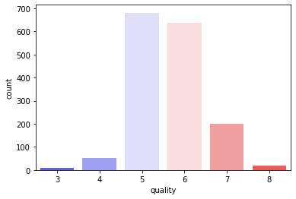
3. Quality Count

Slide 7
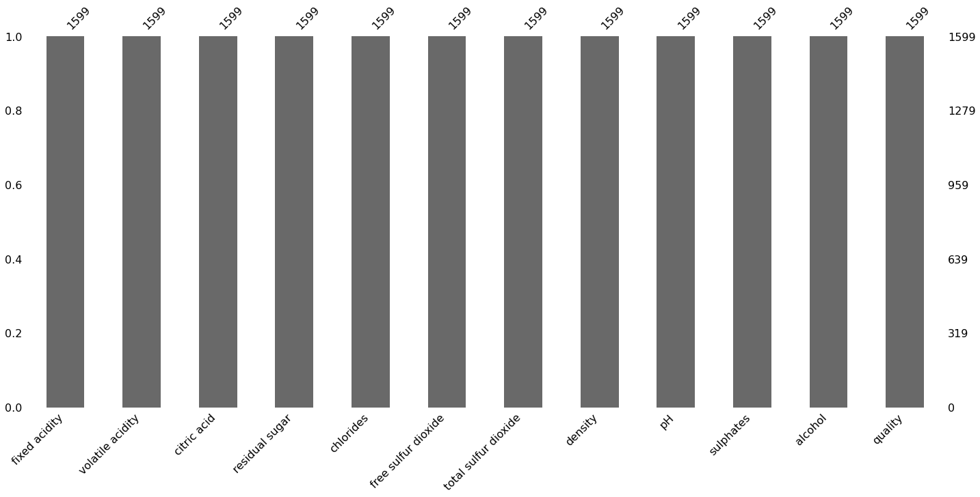
4.Bar Graph

Slide 8
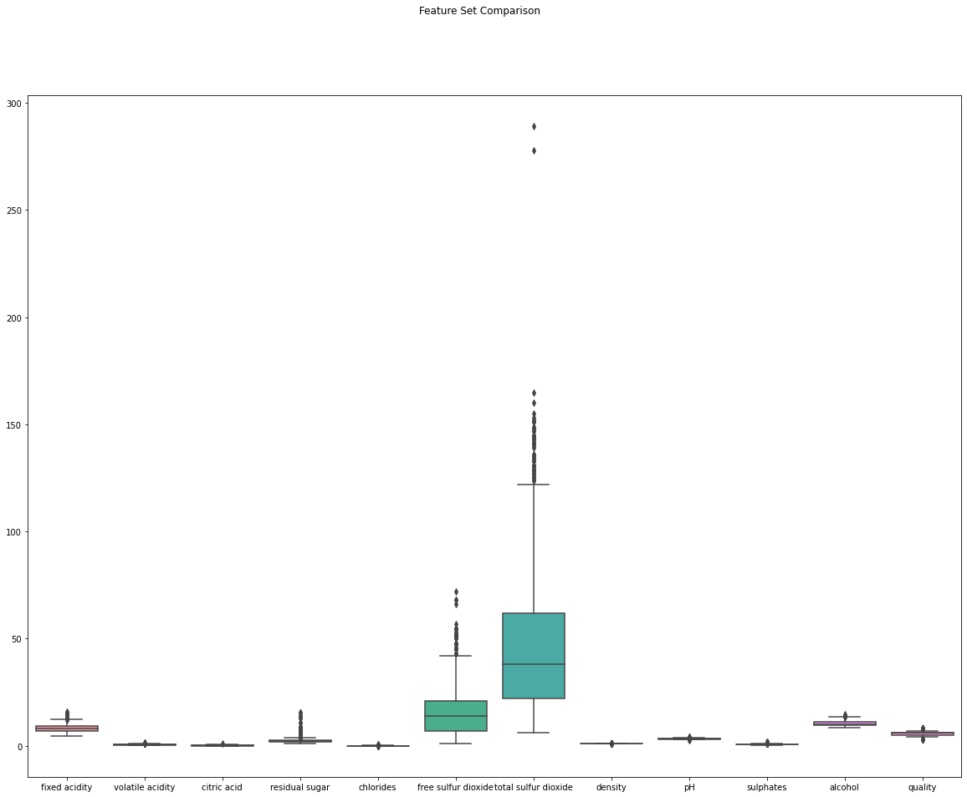
5. Box Plot with Outliers

Slide 9
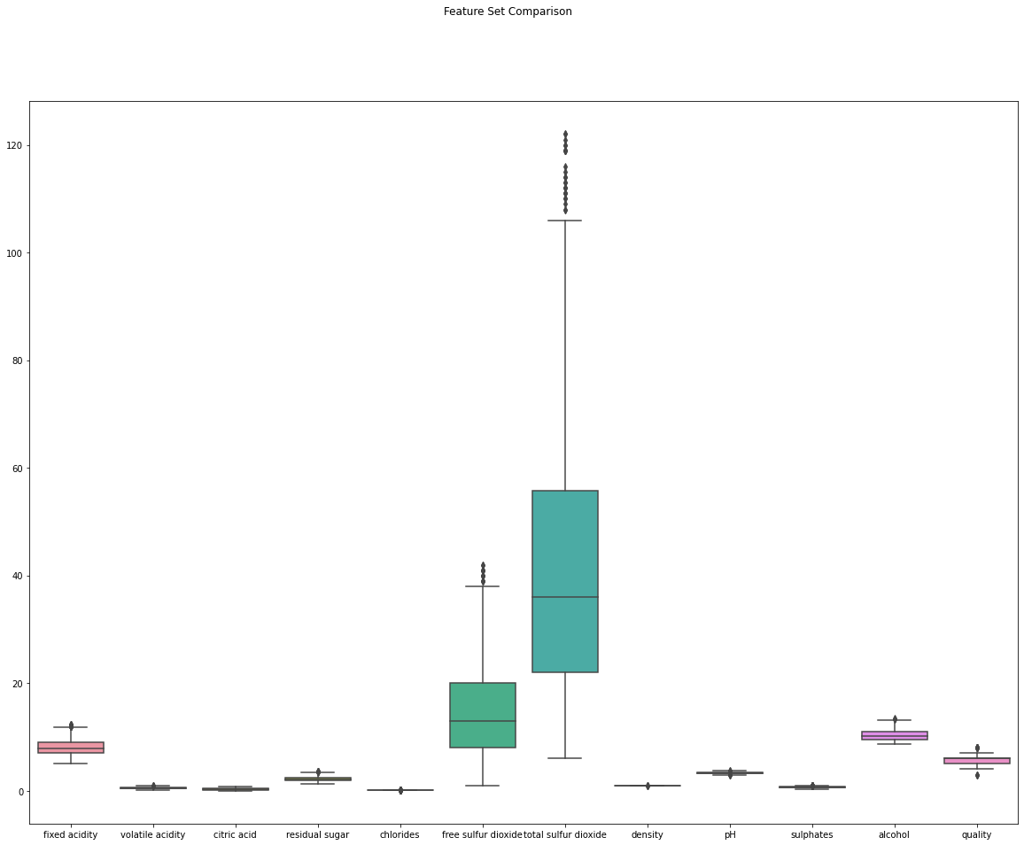
Box Plot after removing outliers:

Slide 10
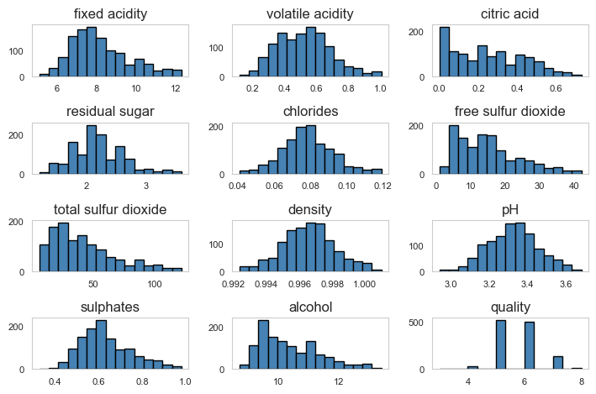
1-D Visualization

Slide 11
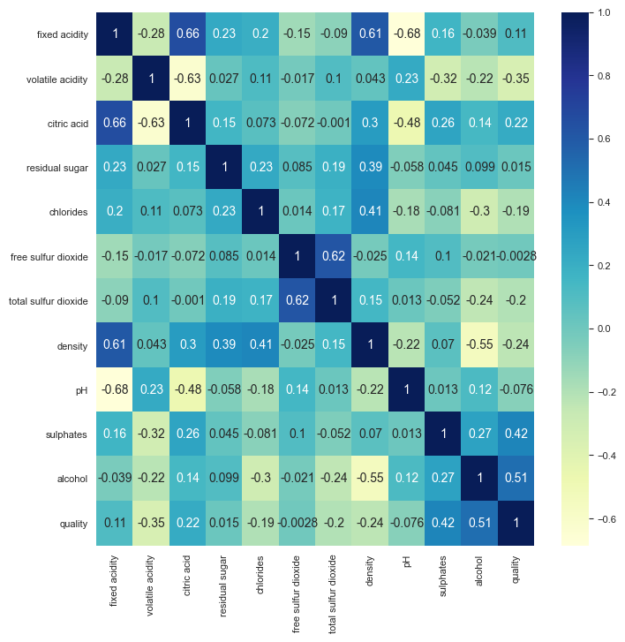
Sweetviz report & 2-D Visualization
file:///C:/Users/amuez/SWEETVIZ_REPORT.html

Slide 12
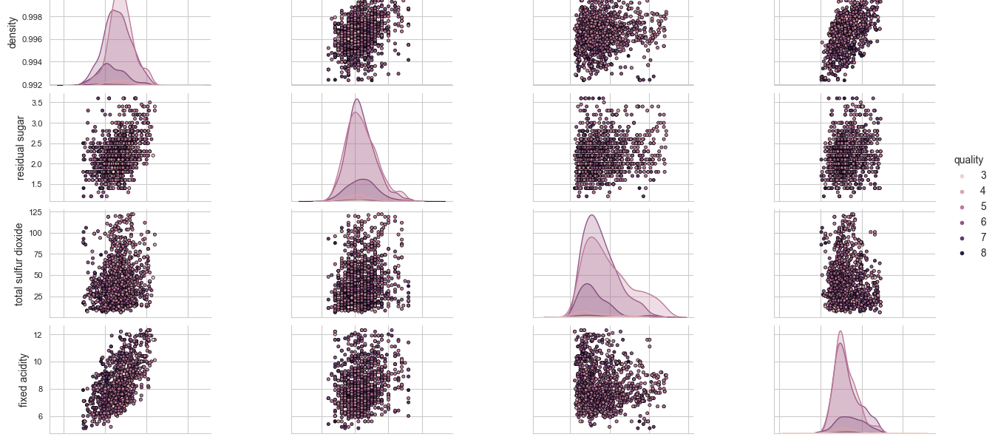
Pairwise Plot

